Slide 1





service-oriented architecture
business services ^{BS BS BS BS BS BS}
message bus
process choreographer service orchestrator
enterprise services ^{ES ES ES ES ES ES}
owned by infrastructure or shared services teams
application services ^{AS}
application services ^{AS}
infrastructure services
IS

Slide 2


service-oriented architecture
business services ^{BS BS BS BS BS BS}
message bus
process choreographer service orchestrator
enterprise services ^{ES ES ES ES ES ES}
owned by infrastructure or shared services teams
fine-grained
application services ^{AS}
application services ^{AS}
infrastructure services
IS

Slide 3

service-oriented architecture
business services ^{BS BS BS BS BS BS}
message bus
process choreographer service orchestrator
enterprise services ^{ES ES ES ES ES ES}
owned by infrastructure or shared services teams
enterprise-level
fine-grained
application services ^{AS}
application services ^{AS}
infrastructure services
IS

Slide 4
service-oriented architecture
business services ^{BS BS BS BS BS BS}
message bus
process choreographer service orchestrator
enterprise services ^{ES ES ES ES ES ES}
owned by infrastructure or shared services teams
concrete
enterprise-level
fine-grained
application services ^{AS}
application services ^{AS}
infrastructure services
IS

Slide 5
service-oriented architecture
business services ^{BS BS BS BS BS BS}
message bus
process choreographer service orchestrator
enterprise services ^{ES ES ES ES ES ES}
owned by infrastructure or shared services teams
concrete
enterprise-level fine-grained
implements non-business functionality to support both enterprise and business services
application services ^{AS}
application services ^{AS}
infrastructure services
IS

Slide 6






service-oriented architecture
business services ^{BS BS BS BS BS BS}
message bus
process choreographer service orchestrator
enterprise services ^{ES ES ES ES ES ES}
owned by infrastructure or shared services teams
concrete
enterprise-level fine-grained
implements non-business functionality to support both enterprise and business services
WriteAudit
CheckUserAccess
LogError
application services ^{AS}
application services ^{AS}
infrastructure services
IS

Slide 7







































service-oriented architecture
business services
BS
BS
BS
BS
BS
BS
message bus
process choreographer service orchestrator
enterprise services
ES
ES
ES
ES
ES
ES
application services
AS
infrastructure services
IS

Slide 8























service-oriented architecture
business services ^{BS BS BS BS BS BS}
business services
BS
BS
BS
BS
BS
BS
message bus
process choreographer service orchestrator
enterprise services
ES
ES
ES
ES
ES
ES
enterprise services
ES
ES
ES
ES
ES
ES
application services ^{AS}
infrastructure services ^{IS}
application services
AS
infrastructure services
IS

Slide 9









service-oriented architecture
business services ^{BS BS BS BS BS BS}
business services ^{BS BS BS BS BS BS}
message bus
process choreographer service orchestrator
enterprise services ^{ES ES ES ES ES ES}
application services ^{AS} infrastructure services ^{IS}
mediation and routing process choreography service orchestration
message enhancement message transformation protocol transformation

Slide 10



























service-oriented architecture
mediation and routing
business services
BS
BS
BS
BS
BS
BS
message bus
enterprise services
ES
ES
ES
ES
ES
ES

Slide 11





















service-oriented architecture
process choreography
request
request
business services
BS
BS
BS
BS
BS
BS
message bus
process choreographer

Slide 12




















service-oriented architecture
service orchestration
request
request
message bus
service orchestrator
enterprise services
ES
ES
ES
ES
ES
ES

Slide 13


service-oriented architecture
service registry
business service
CreateQuote

Slide 14
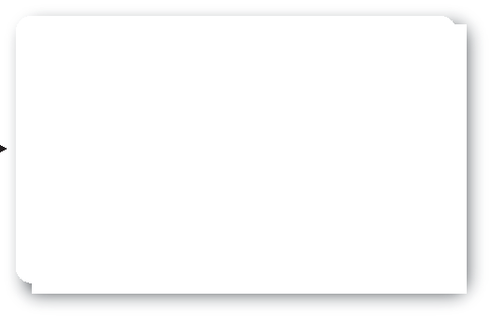





service-oriented architecture
service registry
servic
business service
service
erv
CreateQuote
registry
service registry

Slide 15





service-oriented architecture
service registry
servic
business service
service
erv
CreateQuote
registry
CreateQuote calcQuote
https://grid1/CalcQuote
saveQuote rmi://atlas:1299/saveQuote
service registry

Slide 16


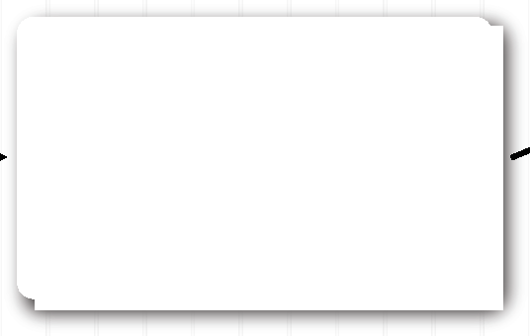












service-oriented architecture
service registry
calcQuote()
enterprise service
servic
business service
service registry
CreateQuote
enterprise service
saveQuote()
CreateQuote calcQuote
https://grid1/CalcQuote
saveQuote rmi://atlas:1299/saveQuote
service registry

Slide 17








service-oriented architecture
service registry
calcQuote()
enterprise service
servic
business service
service registry
CreateQuote
enterprise service
saveQuote()
location, name, and implementation transparency
CreateQuote calcQuote
https://grid1/CalcQuote
saveQuote rmi://atlas:1299/saveQuote
service registry

Slide 18










service-oriented architecture
message enhancement
client application
enhance
enterprise service
servic
message

Slide 19


service-oriented architecture
message enhancement
cusip, mm/dd/yy
sedol, yyyy.mm.dd, symbol
client application
enhance
enterprise service
servic
message

Slide 20













service-oriented architecture
message enhancement
cusip, mm/dd/yy
sedol, yyyy.mm.dd, symbol
client application
enhance
enterprise service
servic
message
037833100
04/23/15
037833100
04/23/15
2046251
2015.04.23
AAPL
2046251
2015.04.23
AAPL

Slide 21










service-oriented architecture
message enhancement
cusip, mm/dd/yy
sedol, yyyy.mm.dd, symbol
client application
enhance
enterprise service
servic
message
037833100
04/23/15
037833100
04/23/15
2046251
2015.04.23
AAPL
2046251
2015.04.23
AAPL
contract decoupling

Slide 22












service-oriented architecture
message transformation
xml
java object
client application
transform
enterprise service
servic
message
xml
xml
java object
java object
contract decoupling

Slide 23



















service-oriented architecture
protocol transformation
client application
SOAP/WS
transform
RMI/IIOP
enterprise service
servic
protocol
ATMI
enterprise service

Slide 24









service-oriented architecture
protocol transformation
client application
SOAP/WS
transform
RMI/IIOP
enterprise service
servic
protocol
ATMI
enterprise service
access decoupling

Slide 25








service-oriented architecture
protocol transformation
client application
SOAP/WS
transform
RMI/IIOP
enterprise service
servic
protocol
ATMI
enterprise service
access decoupling implementation transparency

Slide 26







service-oriented architecture
business services
BS
BS
BS
BS
BS
BS
message bus
process choreographer service orchestrator
enterprise services
ES
ES
ES
ES
ES
ES
application services
AS
infrastructure services
IS

Slide 27




service-oriented architecture
CreateQuote
message bus

Slide 28







service-oriented architecture
CreateQuote
message bus
CreateCustomer
CalcQuote

Slide 29







service-oriented architecture
CreateQuote
message bus
CreateCustomer
CalcQuote
message bus CheckDMV

Slide 30



service-oriented architecture
CreateQuote
message bus
CreateCustomer
CalcQuote
message bus
message bus
AddDriver
AddVehicle
CheckDMV

Slide 31

service-oriented architecture
CreateQuote
message bus
CreateCustomer
CalcQuote
message bus
message bus
AddDriver
AddVehicle
CheckDMV
message bus
WriteAudit

Slide 32



















service-oriented architecture
business services
BS
BS
BS
BS
BS
BS
message bus
process choreographer service orchestrator
enterprise services
ES
ES
ES
ES
ES
ES
application services
AS
infrastructure services
IS

Slide 33























service-oriented architecture
business services
BS
BS
BS
BS
BS
BS
message bus
process choreographer service orchestrator
enterprise services
ES
ES
ES
ES
ES
ES
application services infrastructure services
AS
IS
maximize canonicality

Slide 34
service-oriented architecture
business services
BS
BS
BS
BS
BS
BS
message bus
process choreographer service orchestrator
enterprise services
ES
ES
ES
ES
ES
ES
infrastructure services ^{IS}
application services infrastructure services
AS
IS
maximize canonicality maximize reuse

Slide 35
auto and homeowners insurance division
life insurance division
commercial insurance division
disability insurance division
casualty insurance division
travel insurance division

Slide 36







auto and homeowners insurance division
customer
customer
life insurance division
customer
customer
commercial insurance division
disability insurance division
customer
customer
casualty insurance division
travel insurance division

Slide 37














auto and homeowners insurance division
life insurance division
commercial insurance division
customer service
disability insurance division
casualty insurance division
travel insurance division

Slide 38
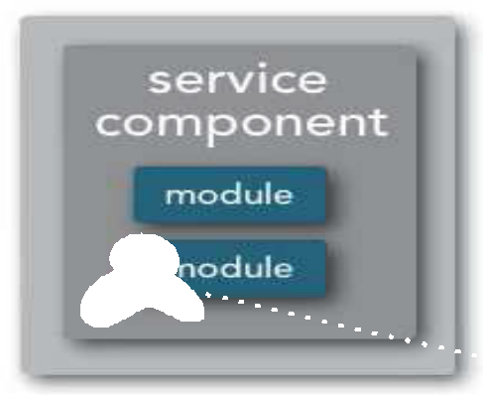
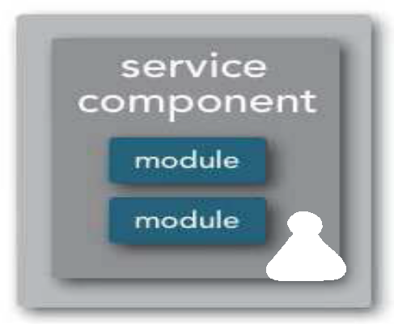







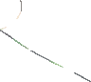


Code Reuse (Over Time)
checkout
ESB-SOA
shipping
Customer

Slide 39








































service-oriented architecture
business services
BS
BS
BS
BS
BS
BS
message bus
process choreographer service orchestrator
enterprise services
ES
ES
ES
ES
ES
ES
application services
AS
infrastructure services
IS

Slide 40








service-oriented architecture
business services
BS
BS
BS
BS
BS
BS
message bus
process choreographer service orchestrator
enterprise services
ES
ES
ES
ES
ES
ES
application services infrastructure services
AS
IS
operationally coupled

Slide 41







service-oriented architecture
business services
BS
BS
BS
BS
BS
BS
message bus
process choreographer service orchestrator
enterprise services
ES
ES
ES
ES
ES
ES
application services infrastructure services
AS
IS
operationally coupled incremental change

Slide 42













service-oriented architecture
business services
BS
BS
BS
BS
BS
BS
message bus
process choreographer service orchestrator
enterprise services
ES
ES
ES
ES
ES
ES
application services infrastructure services
AS
IS
operationally coupled incremental change

Slide 43












service-oriented architecture
business services
BS
BS
technical
BS
BS
BS
BS
message bus
process choreographer service orchestrator
enterprise services
ES
ES
ES
ES
ES
ES
partitioning
application services infrastructure services
AS
IS
operationally coupled incremental change

Slide 44


















































service-oriented architecture
business services
BS
BS
BS
BS
BS
BS
message bus
process choreographer service orchestrator
enterprise services
ES
ES
ES
ES
ES
ES
infrastructure services ^{IS}
application services
AS
infrastructure services
IS

Slide 45







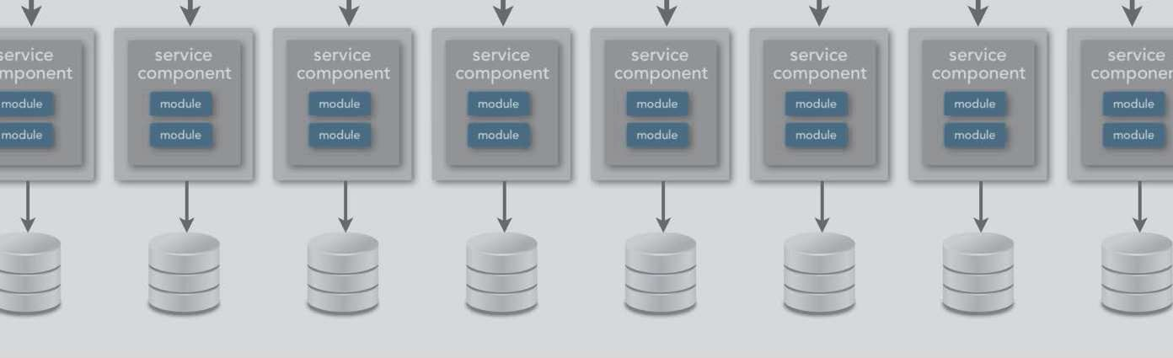
miCRosErvIceS aRChiTeCtUre

Slide 46
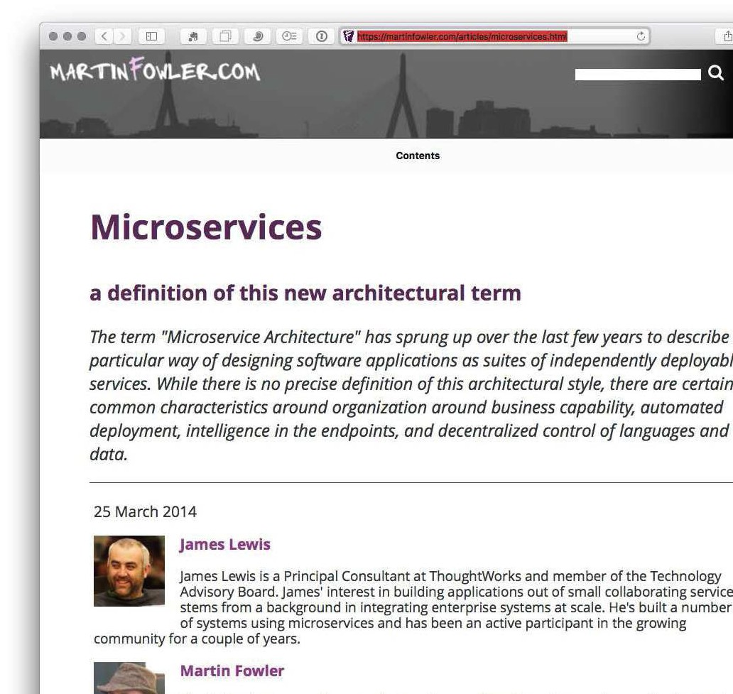

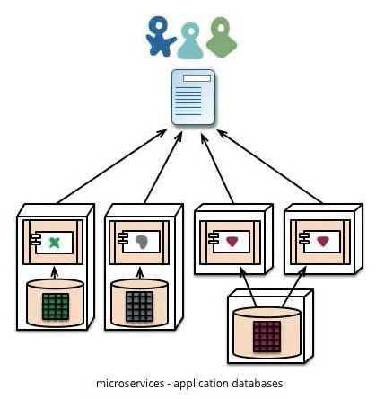
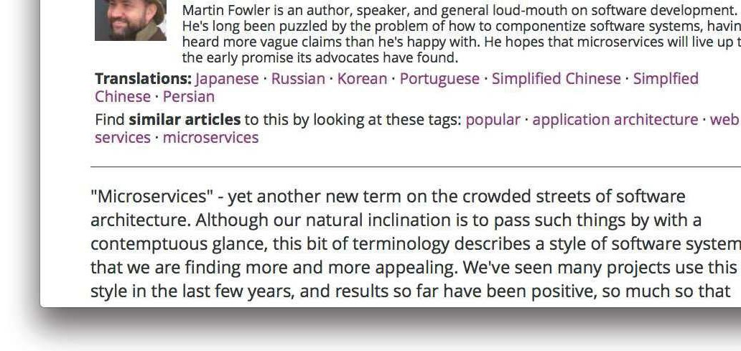
microservices
https://martinfowler.com/articles/microservices.html

Slide 47
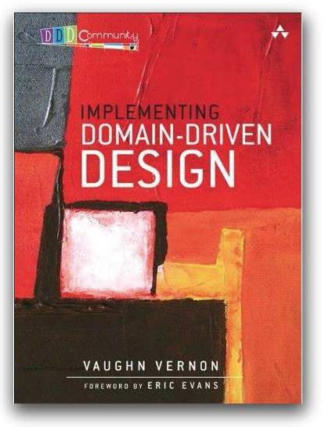
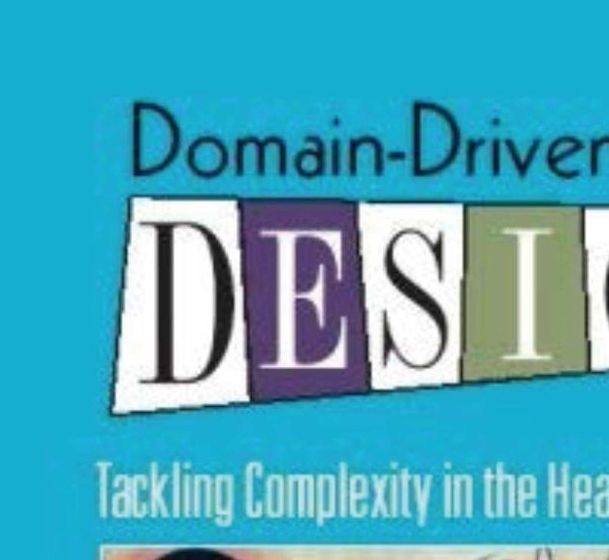







domain driven design

Slide 48







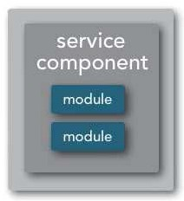



microservices architecture
client requests
client requests
client requests
api layer

Slide 49







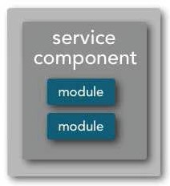
microservices architecture
distributed architecture
client requests
client requests
client requests
api layer

Slide 50





















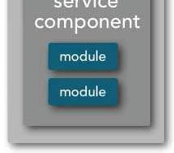
microservices architecture
distributed architecture
client requests
client requests
client requests
api layer

Slide 51




microservices architecture
separately deployed components
client requests
client requests
client requests
api layer

Slide 52








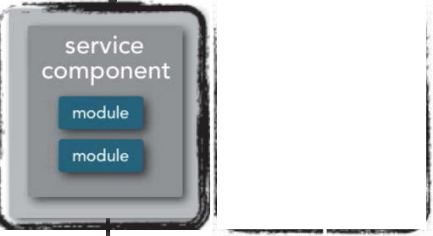
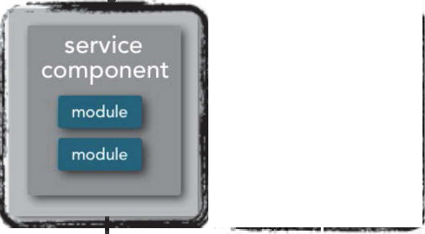
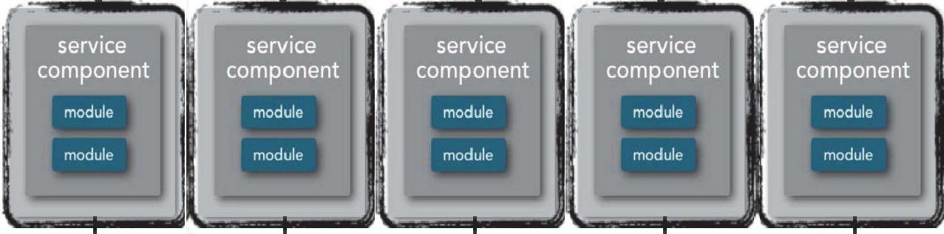




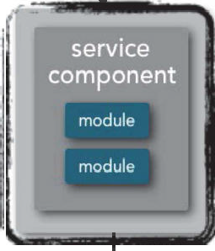

microservices architecture
separately deployed components
client requests
client requests
client requests
api layer
api layer

Slide 53




microservices architecture
service component
client requests
client requests
client requests
api layer

Slide 54





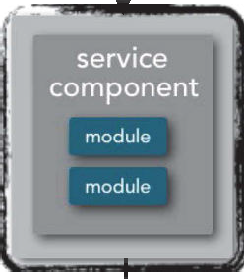
microservices architecture
service component
client requests
client requests
client requests
api layer

Slide 55



microservices architecture
service component
client requests
client requests
client requests
api layer
microservices is a label, not a description.

Slide 56




microservices architecture
bounded context
client requests
client requests
client requests
api layer

Slide 57





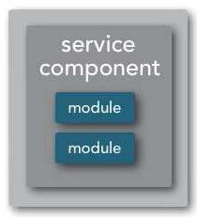
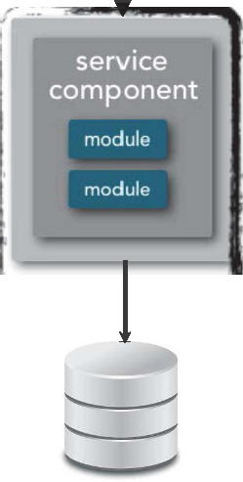
microservices architecture
bounded context
client requests
client requests
client requests
api layer

Slide 58


bounded context ≠ entity
checkout shipping

Slide 59









smart endpoints, dumb pipes

Slide 60






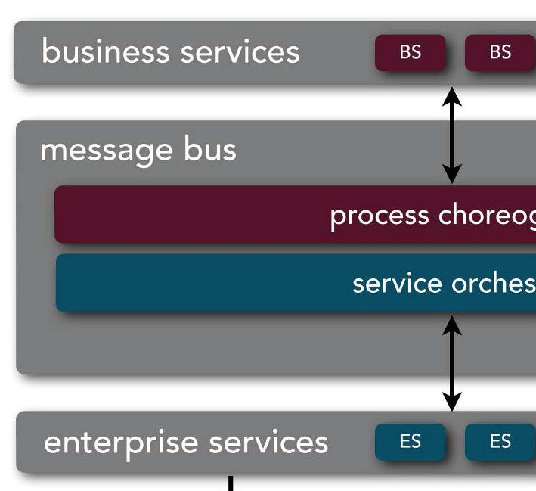
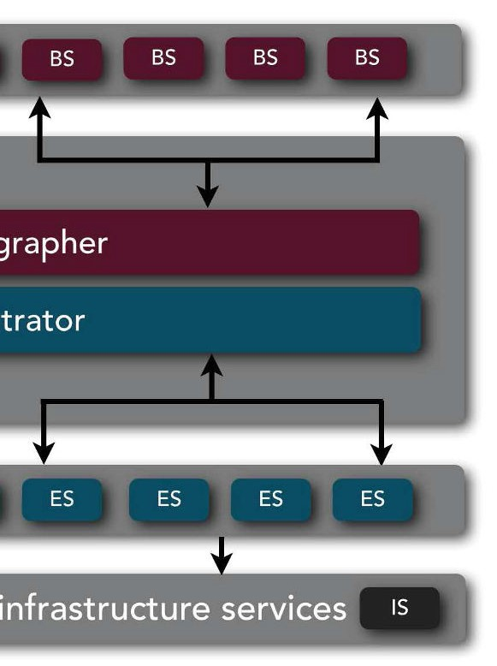




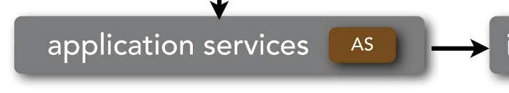

smart endpoints, dumb pipes

Slide 61





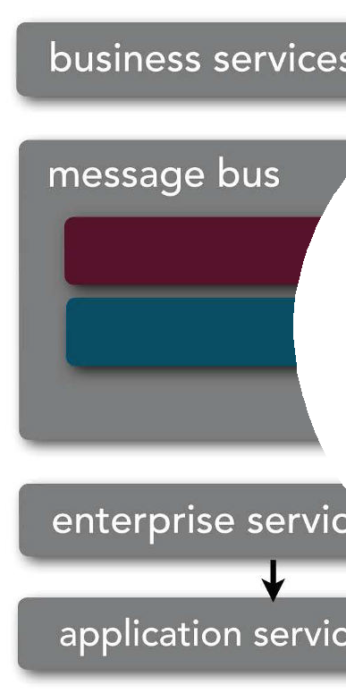

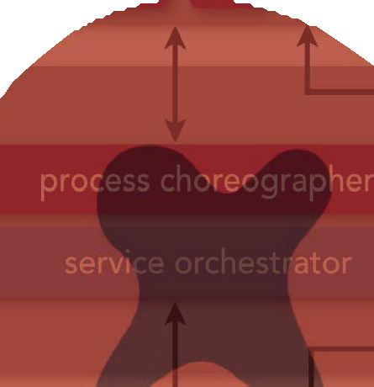








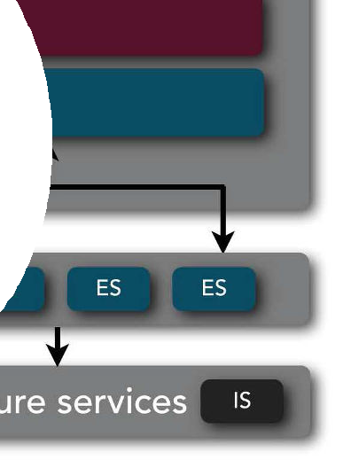









smart endpoints, dumb pipes

Slide 62





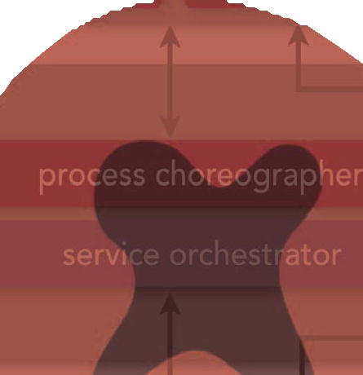










smart endpoints, dumb pipes
<— HTTP —>

Slide 63





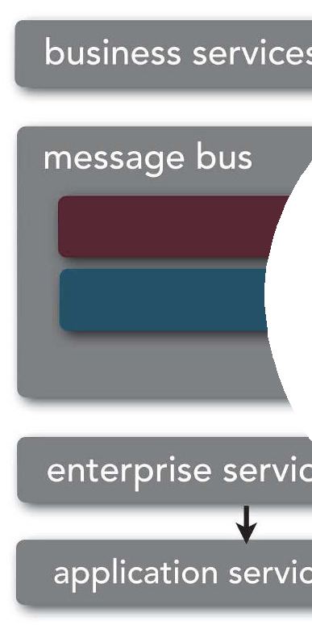









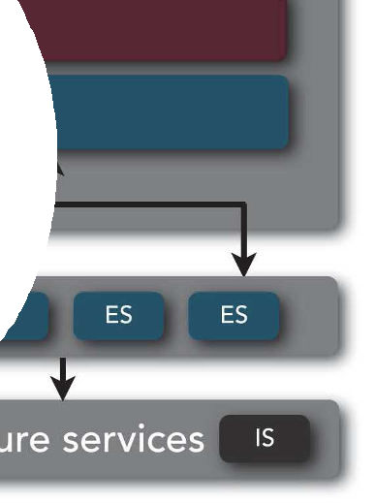








smart endpoints, dumb pipes
<— HTTP —>
<— messaging —>

Slide 64

standardize on integration, not platform

Slide 65
standardize on integration, not platform
embrace polyglot solutions where sensible

Slide 66









standardize on integration, not platform
embrace polyglot solutions where sensible
Standardize in the gaps between services - be flexible about what happens inside the boxes

Slide 67












standardize on integration, not platform
embrace polyglot solutions where sensible
Standardize in the gaps between services - be flexible about what happens inside the boxes
Pick some sensible conventions, and stick with them.

Slide 68
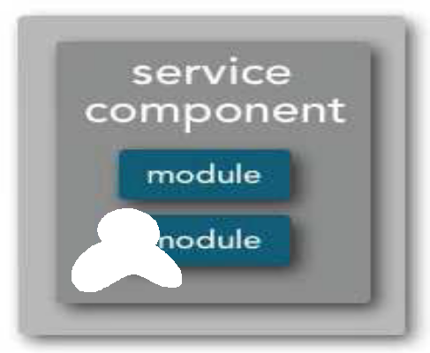
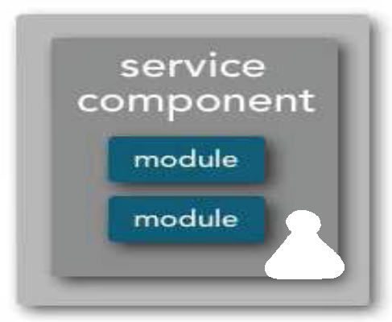




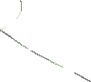
checkout
SOA
shipping

Slide 69
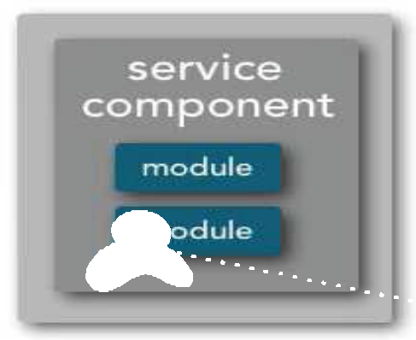
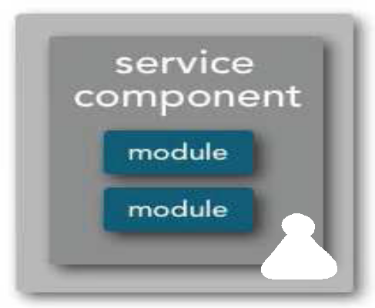










checkout
SOA
shipping
Customer

Slide 70
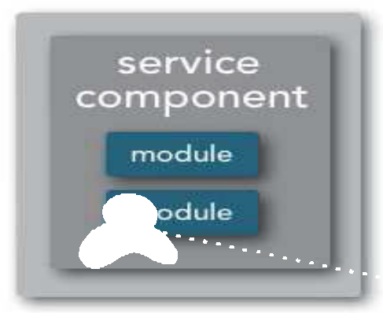
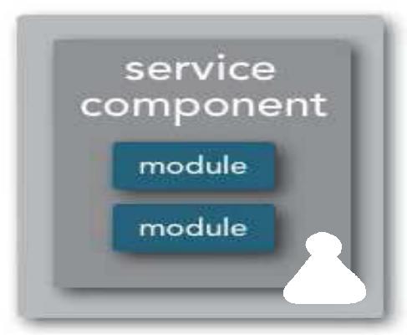










checkout
SOA
shipping
Customer
reuse

Slide 71









checkout
SOA
shipping
Customer
reuse
high coupling

Slide 72


checkout
microservices
shipping

Slide 73
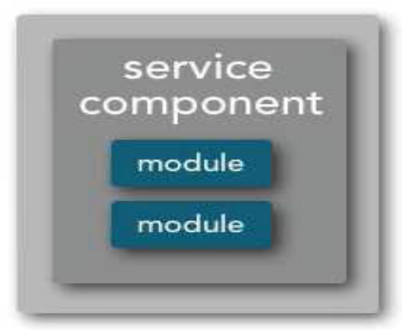
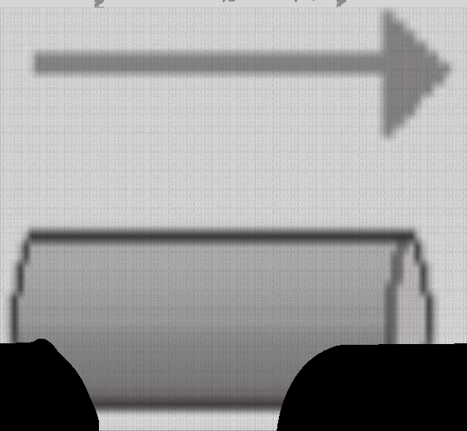










checkout
microservices
shipping

Slide 74









prefer duplication over coupling
microservices
checkout shipping

Slide 75






technical consistency
service behavior

Slide 76








technical consistency
integration
service behavior

Slide 77











technical consistency
integration
metrics
service behavior

Slide 78













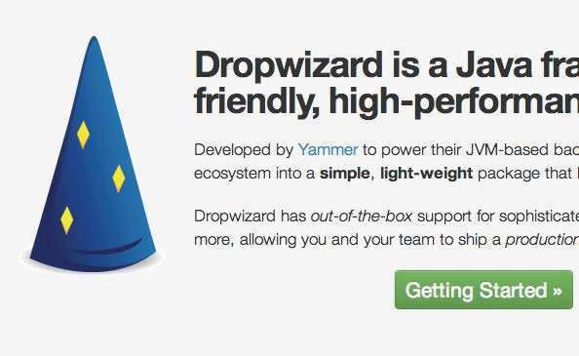















technical consistency
integr
ation
vior
ehavior
metrics
service b
downstream

Slide 79













technical consistency
integr
ation
vior
ehavior
metrics
service b
downstream
Consider Service Templates to make it easy to do the right thing!

Slide 80
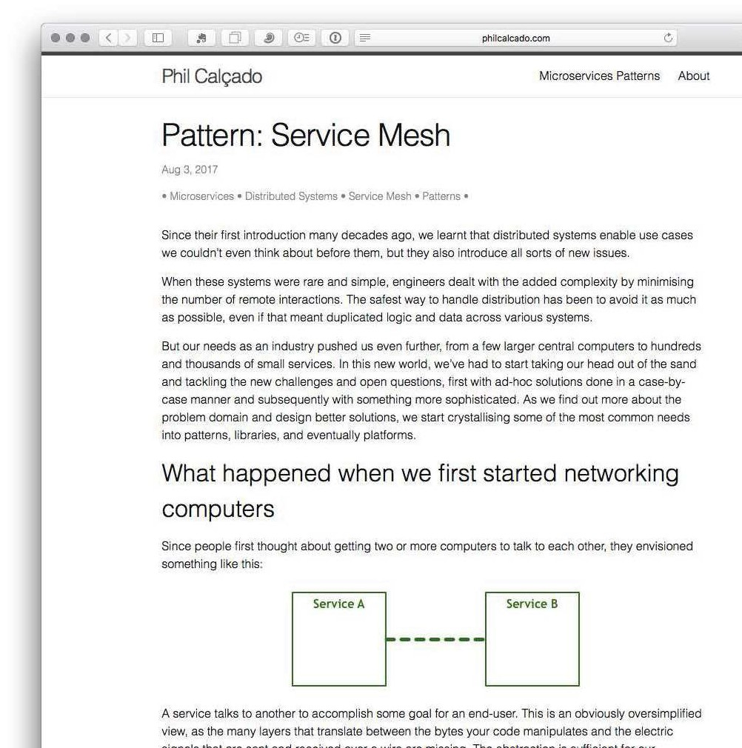

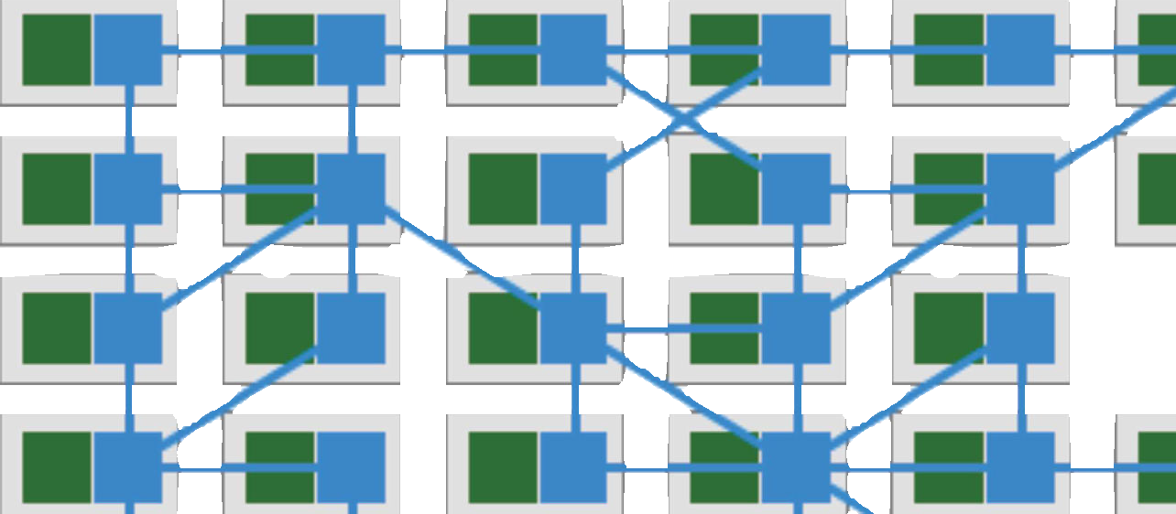
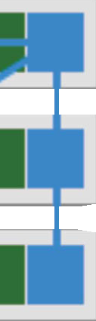























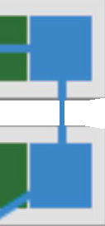
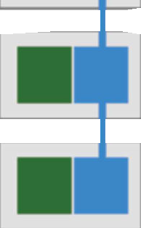


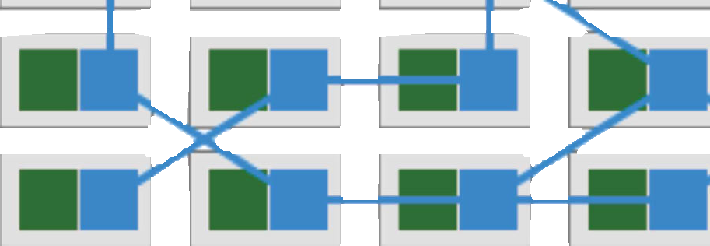








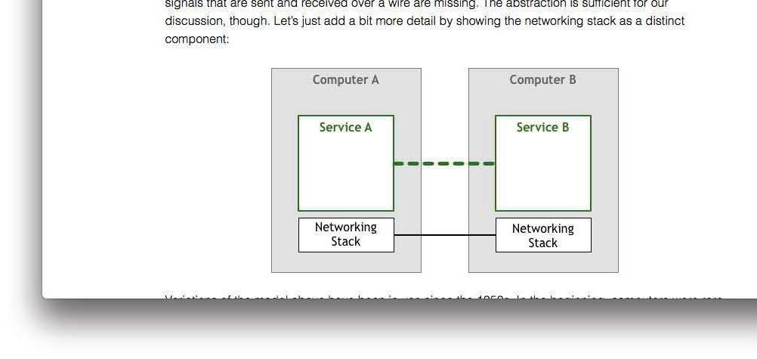















the rise of service meshes

Slide 81
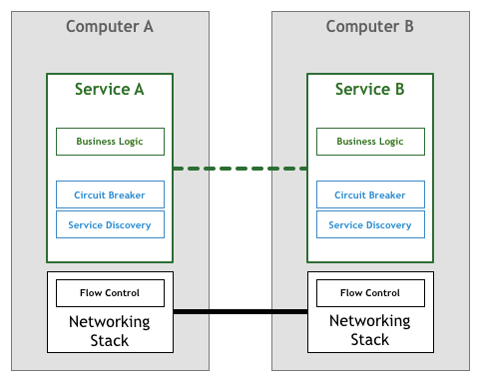
the rise of service meshes

Slide 82
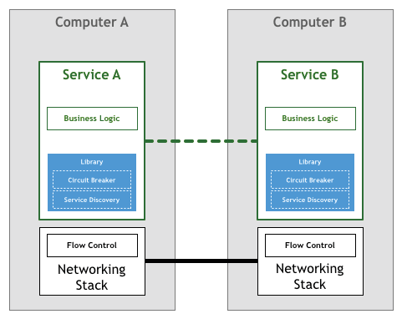
the rise of service meshes

Slide 83
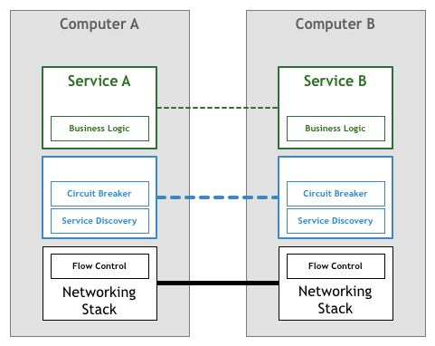

the rise of service meshes

Slide 84



the rise of service meshes

Slide 85


the rise of service meshes

Slide 86
























two reuse solutions

Slide 87



governance
decentralized

Slide 88

governance
decentralized

Slide 89

decentralized data management

Slide 90

decentralized data management

Slide 91
decentralized data management
ACID versus BASE

Slide 92









decentralized data management
Avoid distributed transactions if at all possible

Slide 93








infrastructure automation

Slide 94
microservices architecture
service orchestration
process claims
process quotes
process
adjustments
update customer
notification
front orchestrator

Slide 95
microservices architecture
service orchestration
process claims
process quotes
process
adjustments
update customer
notification

Slide 96






microservices architecture
service orchestration
process claims
process quotes
process
adjustments
update customer
notification

Slide 97






microservices architecture
service orchestration
process claims
process quotes
process
adjustments
update
notification
customer

Slide 98






microservices architecture
service orchestration
process claims
process quotes
process
adjustments
update customer
notification

Slide 99

Microservices

Slide 100





Microservices
diat
mediator

